Slide 1


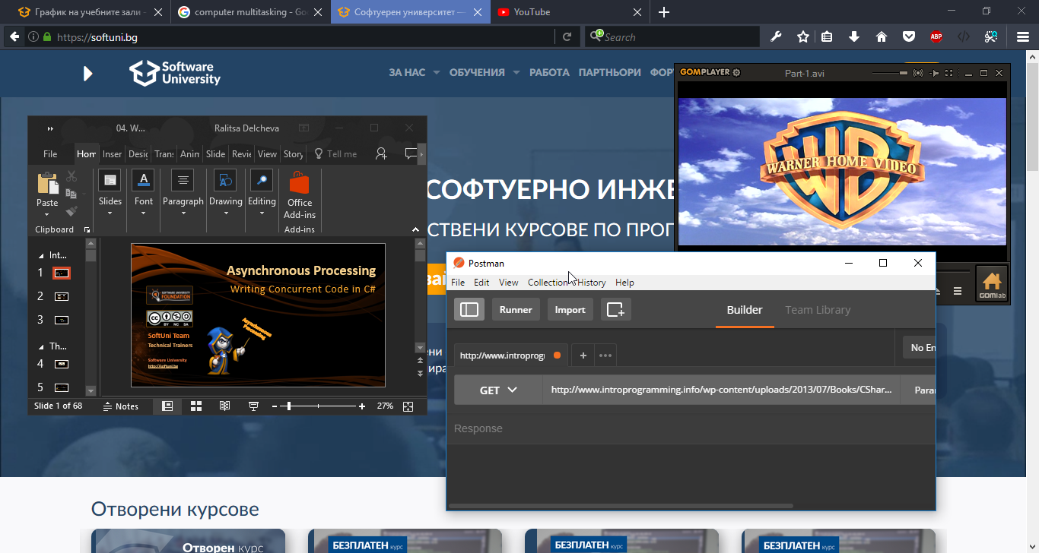

Asynchronous Processing
Writing Concurrent Code in C#
Asynchronous Processing
SoftUni Team
Technical Trainers
Software University
http://softuni.bg

Slide 2
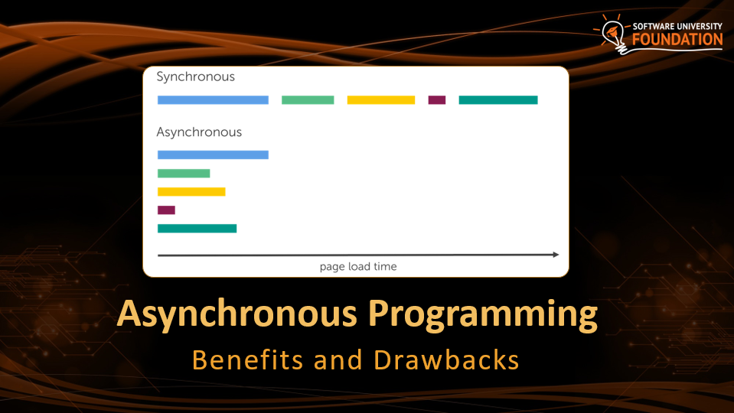
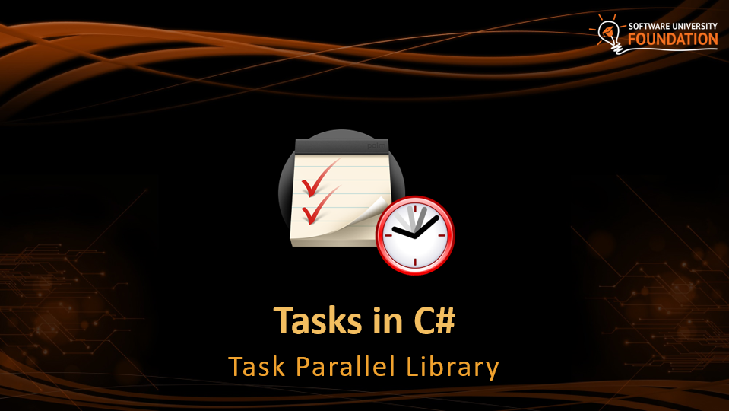
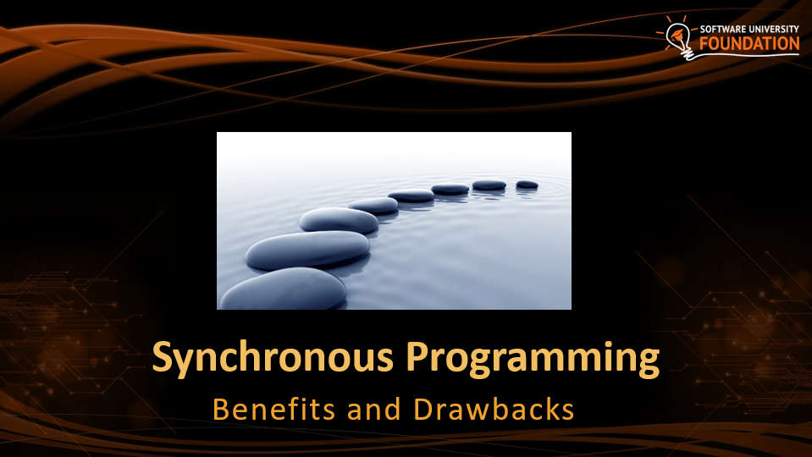
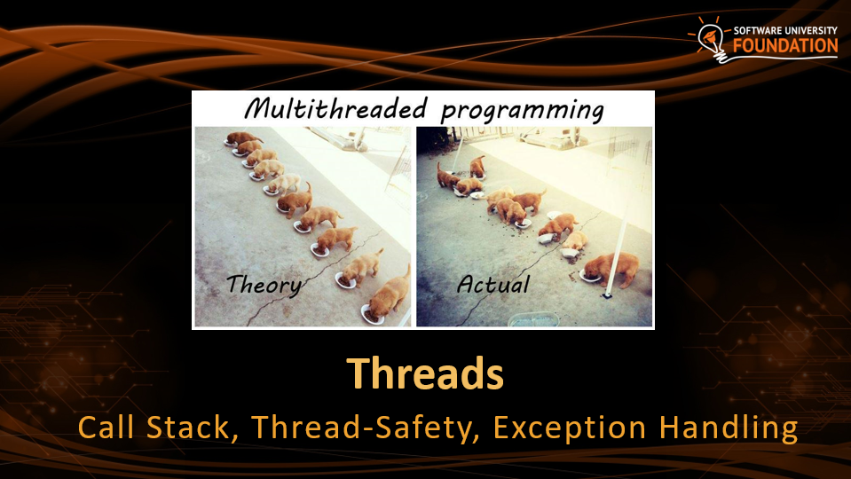
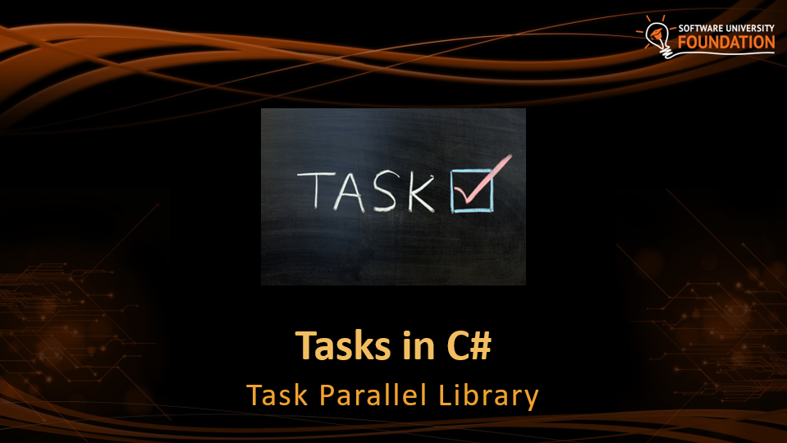
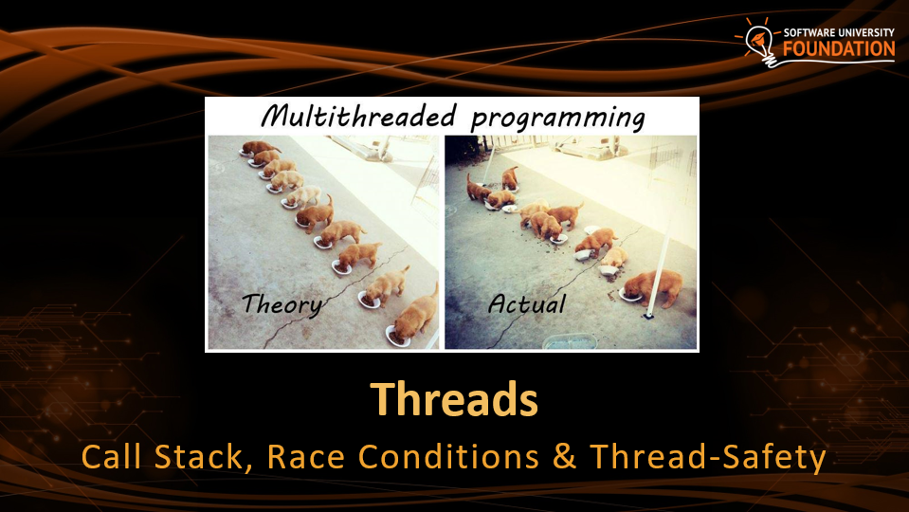
Table of Contents

Slide 3
Have a Question?
sli.do #csharp-web

Slide 4
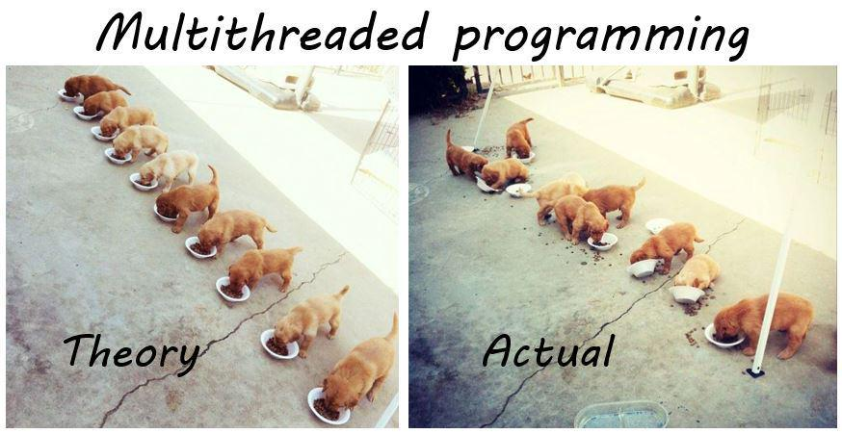
Threads
Call Stack, Thread-Safety, Exception Handling

Slide 5
Threads
A thread is a fundamental unit of code execution
Commonly, programs use more than one thread
In .NET, there is always more than one thread
Each thread has a memory area associated with it known as a Call Stack
Stores local variables
Stores the currently invoked methods in order of invocation

Slide 6
Threads in C#
Threads in C# can be created using the System.Thread class
Constructor accepts a method (delegate) to execute on a separate thread
Thread thread = new Thread(() =>
{
for (int i = 0; i < 10; i++)
{
Console.WriteLine(i);
}
});

Slide 7
System.Thread
Start() – schedules the thread for execution
Join() – waits for the thread to finish its work (blocks the calling thread)
Thread primes = new Thread(() => PrintPrimesInRange(1, 10000));
primes.Start();
Console.WriteLine("Waiting for thread to finish work...");
primes.Join();

Slide 8
Problem: Even Numbers Thread
Print all even numbers in a given range
Printing should be executed on a separate thread
After all numbers are printed print "Thread finished work"
2
4
6
8
10
Thread finished work
1 10

Slide 9
Solution: Even Numbers Thread
// TODO: read start and end numbers
Thread evens = new Thread(() =>
PrintEvenNumbers(start, end));
evens.Start();
evens.Join();
Console.WriteLine("Thread finished work");
// TODO: implement method PrintEvenNumbers

Slide 10
Thread – Example
List<long> numbers = new List<long>();
Thread t = new Thread(() =>
SumOddNumbers(numbers, 10, 100000000L));
t.Start();
Console.WriteLine("What should I do?");
while (true)
{
string command = Console.ReadLine();
if (command == "exit") break;
}
t.Join();
Console interface
remains unblocked

Slide 11
Thread Stack
Each thread has its own stack
The start (bottom) of the stack is the method from which the thread began execution
Each method (frame) stores local variables
...
IsPrime()
PrintAllPrimes()
Main()
...
IsValidUrl
DownloadAsync
background thread
main thread

Slide 12

Thread Race Conditions
A race condition occurs when two or more threads access shared data and they try to change it at the same time
List<int> numbers = Enumerable.Range(0, 10000).ToList();
for (int i = 0; i < 4; i++)
{
new Thread(() =>
{
while (numbers.Count > 0)
numbers.RemoveAt(numbers.Count - 1);
}).Start();
}

Slide 13

Thread Safety
A thread-safe resource can be safely accessed by multiple threads
lock keyword grants access to only one thread at a time
Avoids race conditions
Blocks any other threads until the lock is released
lock (numbers)
{
if (numbers.Count == 0) break;
int lastIndex = numbers.Count - 1;
numbers.RemoveAt(lastIndex);
}

Slide 14
Exception Handling
Exceptions cannot be handled outside a thread
try
{
new Thread(DoWork).Start();
}
catch (Exception ex)
{
Console.WriteLine("Exception!");
}
This part will never be reached
Public static void DoWork()
{
throw new ArgumentNullException();
}

Slide 15
Exception Handling – the Right Way
new Thread(DoWork).Start();
Exceptions should be handled inside the executed method(s)
public static void DoWork()
{
try
{
throw new ArgumentNullException();
}
catch (Exception ex)
{
Console.WriteLine("Exception handled!");
}
}

Slide 16

Synchronous Programming
Benefits and Drawbacks

Slide 17
Synchronous Programming
Executing program components sequentially
i.e. "Sequential programming"
Actions happen one after another
Uses a single thread of a single process
Components wait for previous components to finish
Program resources are accessible at all points

Slide 18
Synchronous Code
Synchronous code is executed step by step
static void Main()
{
int n = int.Parse(Console.ReadLine());
PrintNumbersInRange(0, 10);
Console.WriteLine("Done.");
}
static void PrintNumbersInRange(int a, int b)
{
for (int i = a; i <= b; i++)
{
Console.WriteLine(i);
}
}
int n = int.Parse(..)
PrintNumbersInRange()
Console.WriteLine(..)
...

Slide 19
Synchronous Code - Long Running Operation
Console.Write("Enter your name: ");
string name = Console.ReadLine();
for (int i = 0; i < int.MaxValue; i++)
{
// Execute some operations here
}
Console.WriteLine($"Hello, {name}!");
You will have to wait for the long-running operation to finish before you can see the greeting

Slide 20
Synchronous Programming Drawbacks
If one component is blocked, the entire program is blocked
UI may become unresponsive
No utilization of multi-core systems
CPU-demanding tasks delay execution of all other tasks
Accessing resources blocks entire program
Especially problematic with web resources

Slide 21
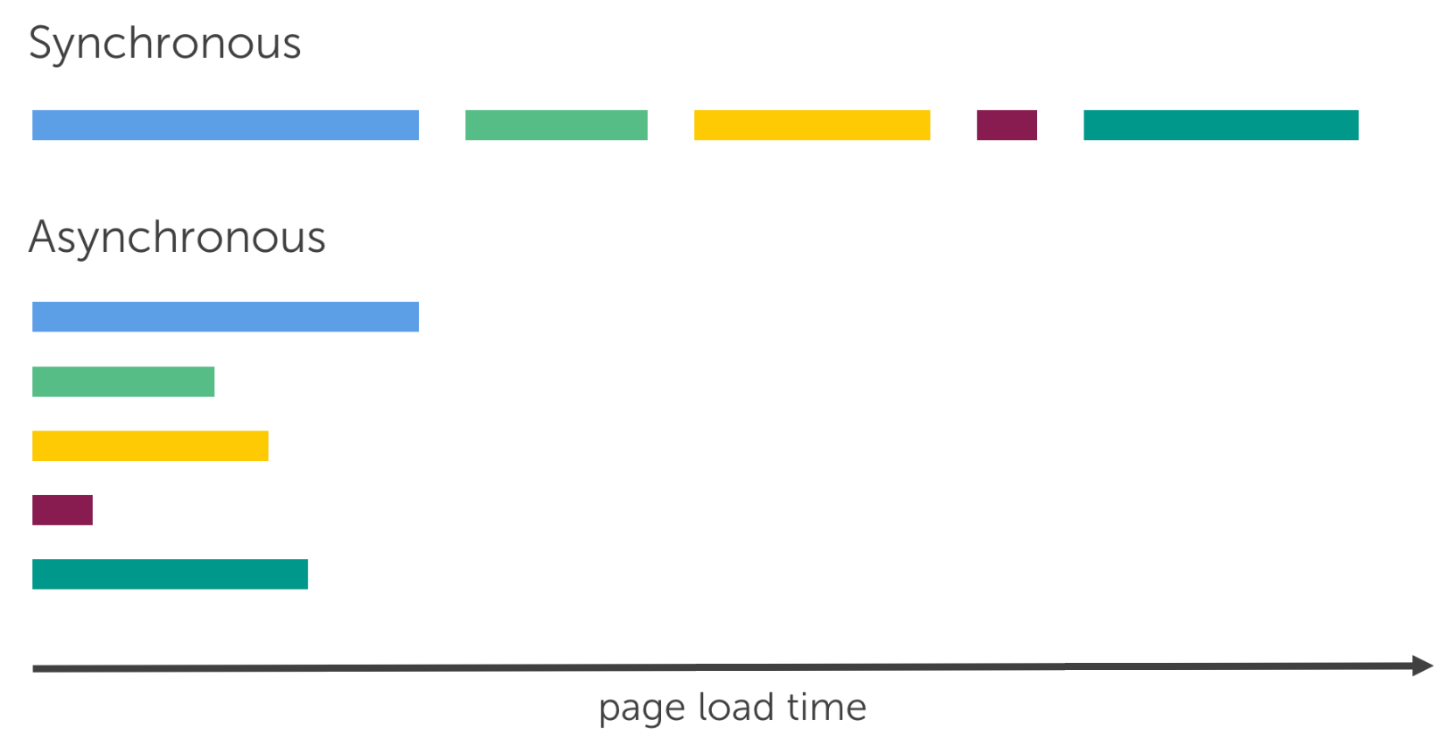
Asynchronous Programming
Benefits and Drawbacks

Slide 22
Asynchronous Programming
Program components can execute in parallel
Some actions run alongside other actions
Each action can happen in a separate thread
Independent components don't wait for each other
Program resources shared between threads
If one thread uses a resources, others shouldn't use it

Slide 23
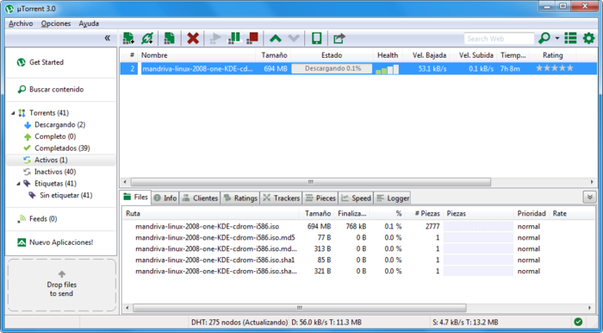
Asynchronous Programming – Benefits
If a component is blocked, other components still run
UI runs separately and always remains responsive
Utilization of multi-core systems
Each core executes one or more threads
CPU-demanding tasks run on "background" threads
Resource access runs on "background" threads

Slide 24
Asynchronous Programming – Drawbacks
Hard to know which code parts are running at a specific time
Harder than usual to debug
Have to protect resources
One thread uses a resource
Other threads must wait for the resource
Hard to synchronize resource access
Deadlocks can occur

Slide 25
Asynchronous Code
Asynchronous programming allows the execution of code simultaneously
int n = int.Parse(Console.ReadLine());
PrintNumbersInRange(0, 100);
var task = Task.Run(() =>
PrintNumbersInRange(100, 200));
Console.WriteLine("Done.");
task.Wait();
int n = int.Parse(..)
for (0..100)
Console.WriteLine(…)
for (100..200)
Wait()

Slide 26

Tasks in C#
Task Parallel Library

Slide 27
Tasks in C#
A task is a high-level representation of concurrent work
Runs in parallel with the main thread
May not run on a new thread (the CLR decides)
Offers several operations
Creating, running and returning result
Continuing with another task (chaining several operations)
Proper exception handling
Progress/state reports

Slide 28
Creating Tasks in C#
Creating tasks can be done in several ways
Initialize a new Task object
Task.Run()
Task.Factory.StartNew() – enables additional task customization
Task task = new Task(() => { Console.WriteLine(""); });
Task.Run(() => TraverseMatrix());
Task.Factory.StartNew(() => CopyFileContents("got-s03ep1.avi"),
TaskCreationOptions.LongRunning);

Slide 29
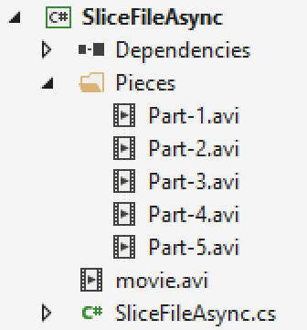
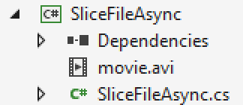
Problem: Slice File
Slice given file into given number of pieces
Save the pieces in a given directory

Slide 30
Solution: Slice a File to Pieces (1)
static void Main(string[] args)
{
string videoPath = Console.ReadLine();
string destination = Console.ReadLine();
int pieces = int.Parse(Console.ReadLine());
SliceAsync(videoPath, destination, pieces);
Console.WriteLine("Anything else?");
while (true) Console.ReadLine();
}

Slide 31
Solution: Slice a File to Pieces (2)
static void SliceAsync(
string sourceFile, string destinationPath, int parts)
{
Task.Run(() =>
{
Slice(sourceFile, destinationPath, parts);
});
}
static void Slice(
string sourceFile, string destinationPath, int parts)
{
// TODO: Implement slice logic
}
Executes on a separate thread

Slide 32


Live Demo: Parallel Image Flips
Read all images from a given directory
Flip the images upside down
Save the flipped images in a given directory

Slide 33
Generic Tasks
Task<T> is a task that will return a result sometime in the future
Task<long> task = Task<long>.Run(() =>
{
long sum = 0;
for (int i = 0; i < 10000; i++) sum += i;
return sum;
});
Console.WriteLine(task.Result);
Blocks the calling thread until the task returns a result

Slide 34
Live Demo: Sum Primes in Range
Sum all prime numbers in given range
Leave the console interface unblocked while calculating the sum
Read commands and print the result only on command "Show"
show
5736397
Print
show
5736397
show
5736397
If the operation time is too long, you will have to wait for the calculations to finish before you can continue reading next command

Slide 35
Task Exception Handling
Exceptions that have occurred within the body of a Task can be captured and handled outside of it
var task = SliceAsync(VideoPath, DestinationPath, 5);
try
{
task.Wait();
}
catch (AggregateException ex)
{
// Handle exception...
}
You can use the AggregateException to wrap all exceptions thrown by different threads

Slide 36
Tasks with async and await
The keywords async and await are always used together
async hints the compiler that the method might run in parallel
Does not make a method run asynchronously (await makes it)
Tells the compiler "this method could wait for a resource or operation"
If it starts waiting, return to the calling method
When the wait is over, go back to called method
static async void SliceFileAsync(string file, int parts)

Slide 37
Tasks with async and await (2)
await is used in a method which has the async keyword
Saves the context in a state machine
Marks waiting for a resource (a task to complete)
Resource should be a Task<T>
Returns T result from Task<T> when it completes
await DownloadStringAsync("http://softuni.bg");
Returns Task<string>

Slide 38
async and await – Example
static void Main()
{
DownloadFileAsync(FileUrl, "book.pdf");
// Do some other work
}
static async void DownloadFileAsync(string url, string fileName)
{
Console.WriteLine("Downloading...");
await Task.Run(() =>
{
// Download the file
});
Console.WriteLine("Download successful.");
}
The calling thread exits the method on await

Slide 39
async and await – Example
static void Main()
{
DownloadFileAsync(FileUrl, "book.pdf");
// Do some other work
}
static async void DownloadFileAsync(string url, string fileName)
{
Console.WriteLine("Downloading...");
await Task.Run(() =>
{
// Download the file
});
Console.WriteLine("Download successful.");
}
When the waiting is over, the calling thread proceeds with method execution

Slide 40
async and await – Example
static void Main()
{
DownloadFileAsync(FileUrl, "book.pdf");
// Do some other work
}
static async void DownloadFileAsync(string url, string fileName)
{
Console.WriteLine("Downloading...");
await Task.Run(() =>
{
// Download the file
});
Console.WriteLine("Download successful.");
}
After the method is over the calling thread gets back to the calling method

Slide 41
Live Demo: Tasks with Async and Await
Execute a long running operation
Handle user input while executing the operation
Hello
You typed: Hello
Hello again
You typed: Hello again
Compute: 588889000
Compute: 588889000
Await
You typed: Await
Compute: 588889000
User input handling
Long running operation result

Slide 42
Build-in Async Methods - GetStringAsync
Access to web resources with HttpClient class
Web access with HttpClient class
File processing with FileStream class
GetStringAsync();
GetAsync();
PostAsync();
ReadAsync();
WriteAsync();

Slide 43
Build-in Async Methods: Get Async
Download a file without blocking the console interface
public static async Task GetAsync(string uri = "https://httpbin.org/get")
{
using (HttpClient client = new HttpClient());
{
using ( var r = await client.GetAsync(new Uri(uri)))
{
string result = await r.Content.ReadAsStringAsync();
Console.WriteLine(result);
}
}
}
Base class for sending HTTP requests and receiving HTTP responses

Slide 44
Build-in Async Methods: Get Async
Download a file without blocking the console interface
public static async Task GetAsync(string uri = "https://httpbin.org/get")
{
using (HttpClient client = new HttpClient());
{
using ( var r = await client.GetAsync(new Uri(uri)))
{
string result = await r.Content.ReadAsStringAsync();
Console.WriteLine(result);
}
}
}
Sends a GET request to the specified Uri

Slide 45
Build-in Async Methods: Get Async
Download a file without blocking the console interface
public static async Task GetAsync(string uri = "https://httpbin.org/get")
{
using (HttpClient client = new HttpClient());
{
using ( var r = await client.GetAsync(new Uri(uri)))
{
string result = await r.Content.ReadAsStringAsync();
Console.WriteLine(result);
}
}
}
Base class representing an HTTP entity body and content headers

Slide 46
Build-in Async Methods: Post Async
Download a file without blocking the console interface
public static async Task PostAsync(string url, string data)
{
HttpClient client = new HttpClient();
StringContent queryString = new StringContent(data);
var response = await client.PostAsync(new Uri(url), queryString);
string responseBody = await response.Content.ReadAsStringAsync();
Console.WriteLine(responseBody);
}
Sends a POST request to the specified Uri with the specified query string

Slide 47
Build-in Async Methods: GetStringAsync
Download the HTML of a given URL
static async Task<string> GetWebsiteHtmlAsync(string websiteUrl)
{
HttpClient client = new HttpClient();
string websiteHtml = await client.GetStringAsync(websiteUrl);
Console.WriteLine("Downloaded html");
return websiteHtml;
}

Slide 48
Build-in Async Methods: ReadAsync
Read a file without blocking the console interface
public static async Task<string> ReadFileAsync(string filename)
{
byte[] result;
Console.WriteLine("Reading...");
using (FileStream reader = File.Open(filename, FileMode.Open))
{
result = new byte[reader.Length];
await reader.ReadAsync(result, 0, (int)reader.Length);
Console.WriteLine("File readed");
}
return System.Text.Encoding.UTF8.GetString(result);
}

Slide 49
Build-in Async Methods: WriteAsync
static async Task SaveFile(string filename, byte[] data)
{
using (FileStream stream = new FileStream(filename, FileMode.OpenOrCreate))
{
int length = data.Length;
await stream.WriteAsync(data, 0, length);
}
}

Slide 50
Example: Download File
Download a file without blocking the console interface
static async Task DownloadFileAsync(string url, string fileName)
{
Console.WriteLine("Downloading...");
using (HttpClient client = new HttpClient())
{
var response = await client.GetStringAsync(FileUrl);
Console.WriteLine("File downloaded");
Task writeFile = SaveFile(fileName, response);
writeFile.Wait();
Process.Start(fileName);
}
}
Opens the downloaded file

Slide 51
Example: Download HTML(1)
Download the HTML of given website without blocking the console interface
static async void GetWebsiteHtmlAsync(string websiteUrl)
{
HttpClient client = new HttpClient();
websiteHtml = await client.GetStringAsync(websiteUrl);
Console.WriteLine("Downloaded html");
}

Slide 52
Example: Download HTML(2)
string url = Console.ReadLine();
GetWebsiteHtmlAsync(url);
while (true)
{
string userInput = Console.ReadLine();
if (userInput == "Print")
{
if (websiteHtml != null) Console.WriteLine(websiteHtml);
else Console.WriteLine("Loading...");
}
else Console.WriteLine("Unknown command. Try again...");
}

Slide 53

TCP Networking
TCP Handshake, TCP Listener and Sockets

Slide 54


Transmission Control Protocol
Standard for establishing and maintaining a network conversation
Provides error-free data transmission
The connection is established using a three-way handshake
SYN
Synchronize packet

Slide 55
Transmission Control Protocol
Standard for establishing and maintaining a network conversation
Provides error-free data transmission
The connection is established using a three-way handshake
SYN - ACK
Synchronize
Acknowledgement

Slide 56
Transmission Control Protocol
Standard for establishing and maintaining a network conversation
Provides error-free data transmission
The connection is established using a three-way handshake
ACK
Acknowledgement

Slide 57
Transmission Control Protocol
Standard for establishing and maintaining a network conversation
Provides error-free data transmission
The connection is established using a three-way handshake
Connection Established

Slide 58
TCP Listener
Provides methods that listen for and accept incoming connection requests
private static async Task ServerListen()
{
int port = 8000;
IPAddress ipAddress = IPAddress.Parse("127.0.0.1");
TcpListener server = new TcpListener(ipAddress, port);
server.Start();
// Establish а connection and read request
}

Slide 59
TCP Client
Connecting, sending, and receiving stream data over a network
var client = await listener.AcceptTcpClientAsync();
Console.WriteLine("Client connected.");
byte[] buffer = new byte[1024];
client.GetStream().Read(buffer, 0, buffer.Length);
byte[] data = Encoding.ASCII.GetBytes("Hello!");
client.GetStream().Write(data, 0, data.Length);
client.GetStream().Dispose();
Connecting with client

Slide 60
TCP Client
Connecting, sending, and receiving stream data over a network
var client = await listener.AcceptTcpClientAsync();
Console.WriteLine("Client connected.");
byte[] buffer = new byte[1024];
client.GetStream().Read(buffer, 0, buffer.Length);
byte[] data = Encoding.ASCII.GetBytes("Hello!");
client.GetStream().Write(data, 0, data.Length);
client.GetStream().Dispose();
Reads data from client's NetworkStream

Slide 61
TCP Client
Connecting, sending, and receiving stream data over a network
var client = await listener.AcceptTcpClientAsync();
Console.WriteLine("Client connected.");
byte[] buffer = new byte[1024];
client.GetStream().Read(buffer, 0, buffer.Length);
byte[] data = Encoding.ASCII.GetBytes("Hello!");
client.GetStream().Write(data, 0, data.Length);
client.GetStream().Dispose();
Writes data to client's NetworkStream

Slide 62
TCP Client
Connecting, sending, and receiving stream data over a network
var client = await listener.AcceptTcpClientAsync();
Console.WriteLine("Client connected.");
byte[] buffer = new byte[1024];
client.GetStream().Read(buffer, 0, buffer.Length);
byte[] data = Encoding.ASCII.GetBytes("Hello!");
client.GetStream().Write(data, 0, data.Length);
client.GetStream().Dispose();
Closes the NetworkStream

Slide 63
Socket
Provides methods and properties for network communication
var socket = await listener.AcceptSocketAsync();
byte[] buffer = new byte[1024];
socket.Receive(buffer);
byte[] data = Encoding.ASCII.GetBytes("Hello!");
socket.Send(data);
socket.Shutdown(SocketShutdown.Both);
Connecting with client

Slide 64
Socket
Provides methods and properties for network communication
var socket = await listener.AcceptSocketAsync();
byte[] buffer = new byte[1024];
socket.Receive(buffer);
byte[] data = Encoding.ASCII.GetBytes("Hello!");
socket.Send(data);
socket.Shutdown(SocketShutdown.Both);
Receive data from client

Slide 65
Socket
Provides methods and properties for network communication
var socket = await listener.AcceptSocketAsync();
byte[] buffer = new byte[1024];
socket.Receive(buffer);
byte[] data = Encoding.ASCII.GetBytes("Hello!");
socket.Send(data);
socket.Shutdown(SocketShutdown.Both);
Send data to client

Slide 66
Socket
Provides methods and properties for network communication
var socket = await listener.AcceptSocketAsync();
byte[] buffer = new byte[1024];
socket.Receive(buffer);
byte[] data = Encoding.ASCII.GetBytes("Hello!");
socket.Send(data);
socket.Shutdown(SocketShutdown.Both);
Close connection

Slide 67
Socket
Provides methods and properties for network communication
var socket = await listener.AcceptSocketAsync();
byte[] buffer = new byte[1024];
socket.Receive(buffer);
byte[] data = Encoding.ASCII.GetBytes("Hello!");
socket.Send(data);
socket.Shutdown(SocketShutdown.Both);
Options to disable send/receive

Slide 68
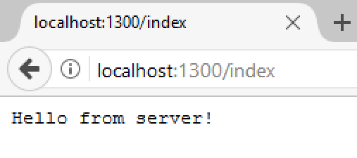
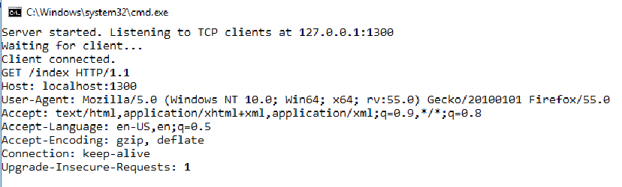

Problem: Simple Web Server
Write a simple web server
Receive a request from a client
Print the request on the console
Write response to client's interface

Slide 69
Solution: Web Server with TcpClient
public async void Connect(TcpListener listener)
{
while (true)
{
// TODO: Accept TcpClient
// TODO: Read request data
// TODO: Send data to client
var message = Encoding.ASCII.GetString(buffer);
Console.WriteLine(message);
client.GetStream().Dispose();
}
}

Slide 70
Solution: Web Server with TcpClient
static void Main()
{
IPAddress address = IPAddress.Parse("127.0.0.1");
int port = 1300;
TcpListener listener = new TcpListener(address, port);
listener.Start();
var task = Task.Run(() => Connect(listener));
task.Wait();
}

Slide 71
Solution: Web Server with Socket
public async void Connect(TcpListener listener)
{
while (true)
{
// TODO: Accept socket
// TODO: Read request data
// TODO: Send data to client
var message = Encoding.ASCII.GetString(buffer);
Console.WriteLine(message);
socket.ShutDown();
}
}

Slide 72
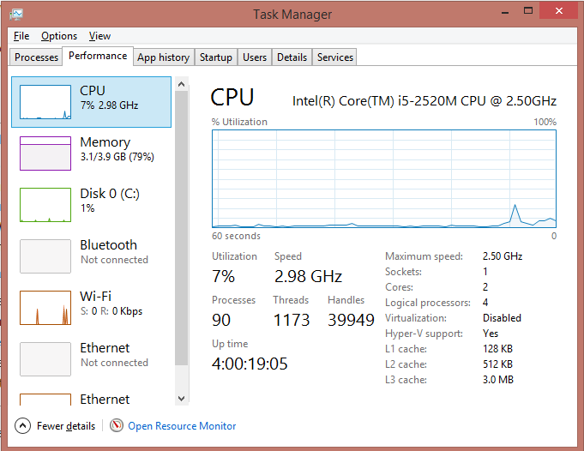
Operating System Concurrency
Synchronous Execution & Multitasking

Slide 73

Instruction Execution
Each program's code is translated to CPU instructions
Program.cs
int a = 5;
int b = 4;
Console.WriteLine(a + b);
Compilation
Program.exe
Single-Core CPU
00DA2655 mov dword ptr [ebp-40h],5
00DA265C mov dword ptr [ebp-44h],4
00DA2663 mov ecx,dword ptr [ebp-40h]
00DA2666 add ecx,dword ptr [ebp-44h]
00DA2669 call 73B5A920
00DA266E nop
Instructions are executed one by one

Slide 74
Multi-Tasking
A computer can run many processes (applications) at once
But its CPU can only execute one instruction at a time
Parellelism is achieved by the operating system's scheduler
Grants each thread a small interval of time to run
program.exe
chrome.exe
winamp.exe
system.exe
program.exe
...
0 5 10 15 20 25 ms

Slide 75
Summary
A thread is a unit of code execution
Each thread has its own call stack
Multithreading means a program can do several
operations in parallel by using many threads
Used to offload CPU-demanding work so the main thread does not block
Can lead to synchronization issues and unexpected results
Tasks facilitate the work with multithreading
async and await keywords

Slide 76







Asynchronous Programming
https://softuni.bg/trainings/courses

Slide 77






SoftUni Diamond Partners

Slide 78






SoftUni Diamond Partners

Slide 79
License
This course (slides, examples, demos, videos, homework, etc.) is licensed under the "Creative Commons Attribution-NonCommercial-ShareAlike 4.0 International" license

Slide 80





Trainings @ Software University (SoftUni)
Software University – High-Quality Education, Profession and Job for Software Developers
softuni.bg
Software University Foundation
http://softuni.foundation/
Software University @ Facebook
facebook.com/SoftwareUniversity
Software University Forums
forum.softuni.bg

